Slide 1
Welcome to the…
GET UP GET MOVING
QUIZ
Click To Continue…

Slide 2
How To Play
-To play this quiz all you
need to do is read
the questions and click on
the answer you
think is correct
Click To Begin…

Slide 3
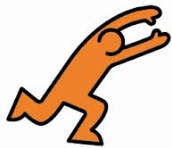
Question 1
Click the image that best
describes “running”

Slide 4
CORRECT!!!
Running is extremely
good for your health and
fitness
Next Question

Slide 5
INCORRECT!!!
Running is extremely
good for your health and
fitness
correct
answer
Next Question

Slide 6
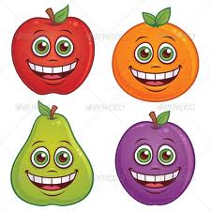
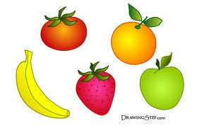
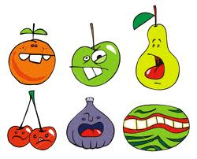
Question 2
How much fruit should you have
at least per day
4 a day
5 a day
6 a day

Slide 7
CORRECT!!!
It is recommended that
you should have at
least 5 different portions
of fruit per day
Next Question

Slide 8
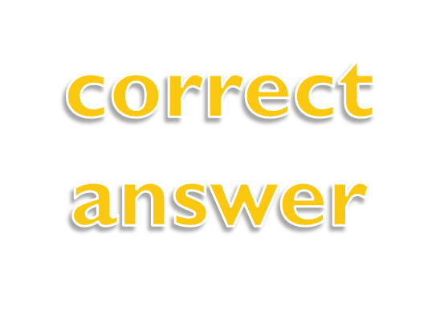
INCORRECT!!!
It is recommended that
you should have at
least 5 different portions
of fruit per day
Next Question

Slide 9
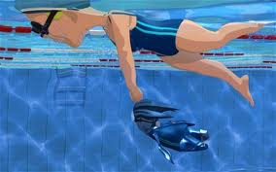
Question 3
How many calories do you burn in
Swimming?
400 calories
450 calories
500 calories

Slide 10
CORRECT!!!
You burn 450 calories
in swimming every
hour!!!
450 calories
Next Question

Slide 11
INCORRECT!!!
You burn 450 calories
in swimming every
hour!!!
450 calories
Next Question

Slide 12
Question 4
Which activity burns the most
calories?
Mowing The Lawn
Paintballing
Handball

Slide 13
CORRECT!!!
You burn 840 calories
Per hour playing
handball
840 calories
Next Question

Slide 14
INCORRECT!!!
You burn 840 calories
Per hour playing
handball
840 calories
Next Question

Slide 15
Question 5
Which activity burns the most
calories?
High jump
Ice Hockey
Jogging--

Slide 16
CORRECT!!!
You burn 860 calories
per hour jogging
860 calories
Next

Slide 17
INCORRECT!!!
You burn 860 calories
Per hour jogging
860 calories
Next

Slide 18
The End
Now to top off your quiz, why not find
out some more info about being healthy.
Or press Esc to end show

